Slide 1

Wien and Stefan-Boltzmann Laws
Senior Theory, NUSH Astro 2022
4 Feb 2022

Slide 2
Planck’s Law
Wait what isn’t this Wien and Stefan Boltzmann why do you want to torture us?
Because Dear Friends, we can.

Slide 3
Planck’s Law
Spectral density of electromagnetic radiation emitted by a black body in thermal equilibrium
So basically it defined Black Body Radiation. Yay.

Slide 4
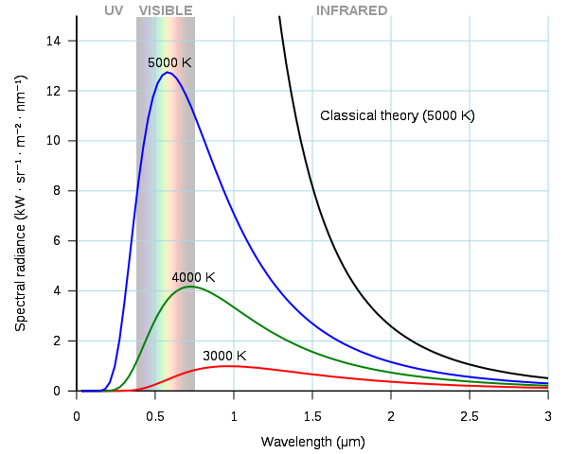

The Law Itself
Classical Curve for BBR:
DIVERGES
from observed intensity at high $f$, low $λ$

Slide 5
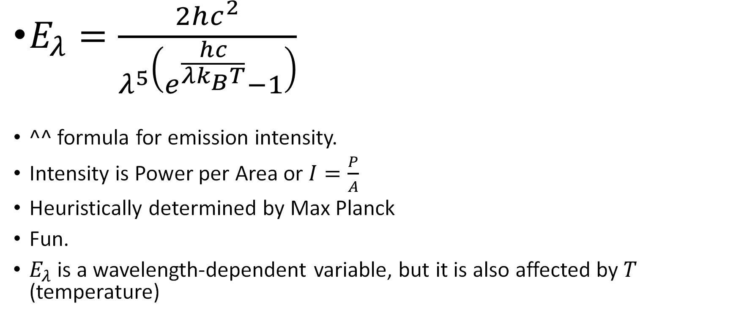
Spectral Emission Intensity
$E_{λ}=\frac{2hc^{2}}{λ^{5}\left(e^{\frac{hc}{λk_{B}T}}−1\right)}$
^^ formula for emission intensity.
Intensity is Power per Area or $I=\frac{P}{A}$
Heuristically determined by Max Planck
Fun.
$E_{λ}$ is a wavelength-dependent variable, but it is also affected by $T$ (temperature)

Slide 6
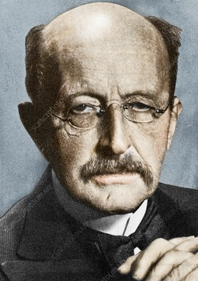

Wien’s Displacement Law
Wavelength with imum emission intensity
Yes.
Formula:
$λ_{peak}=\frac{b}{T}$

Slide 7

The Derivation
Maximising Emission Intensity
$E_{λ}=\frac{2hc^{2}}{λ^{5}\left(e^{\frac{hc}{λk_{B}T}}−1\right)}$ is formula for emission intensity
To maximise we differentiate by $λ$ (assume T is constant in this case)

Slide 8
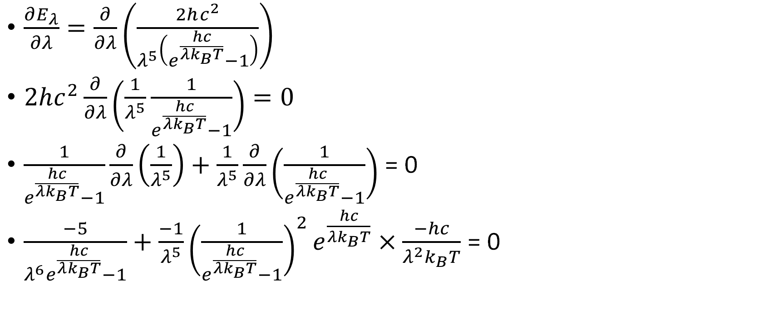
The Derivation (continued)
$\frac{∂E_{λ}}{∂λ}=\frac{∂}{∂λ}\left(\frac{2hc^{2}}{λ^{5}\left(e^{\frac{hc}{λk_{B}T}}−1\right)}\right)$
$2hc^{2}\frac{∂}{∂λ}\left(\frac{1}{λ^{5}}\frac{1}{e^{\frac{hc}{λk_{B}T}}−1}\right)=0$
$\frac{1}{e^{\frac{hc}{λk_{B}T}}−1}\frac{∂}{∂λ}\left(\frac{1}{λ^{5}}\right)+\frac{1}{λ^{5}}\frac{∂}{∂λ}\left(\frac{1}{e^{\frac{hc}{λk_{B}T}}−1}\right)$ = 0
$\frac{−5}{λ^{6}e^{\frac{hc}{λk_{B}T}}−1}+\frac{−1}{λ^{5}}{\left(\frac{1}{e^{\frac{hc}{λk_{B}T}}−1}\right)}^{2}e^{\frac{hc}{λk_{B}T}}×\frac{−hc}{λ^{2}k_{B}T}$ = 0

Slide 9

The Derivation (continued)
$\frac{hc}{{k_{B}Tλ}^{7}}{\left(\frac{1}{e^{\frac{hc}{λk_{B}T}}−1}\right)}^{2}e^{\frac{hc}{λk_{B}T}}=\frac{5}{λ^{6}\left(e^{\frac{hc}{λk_{B}T}}−1\right)}$
$Let x=\frac{hc}{λk_{B}T}$
$xe^{x}=5(e^{x}−1)$
$y=\left(x−5\right)e^{x}+5$ → Root Finding Theorem

Slide 10
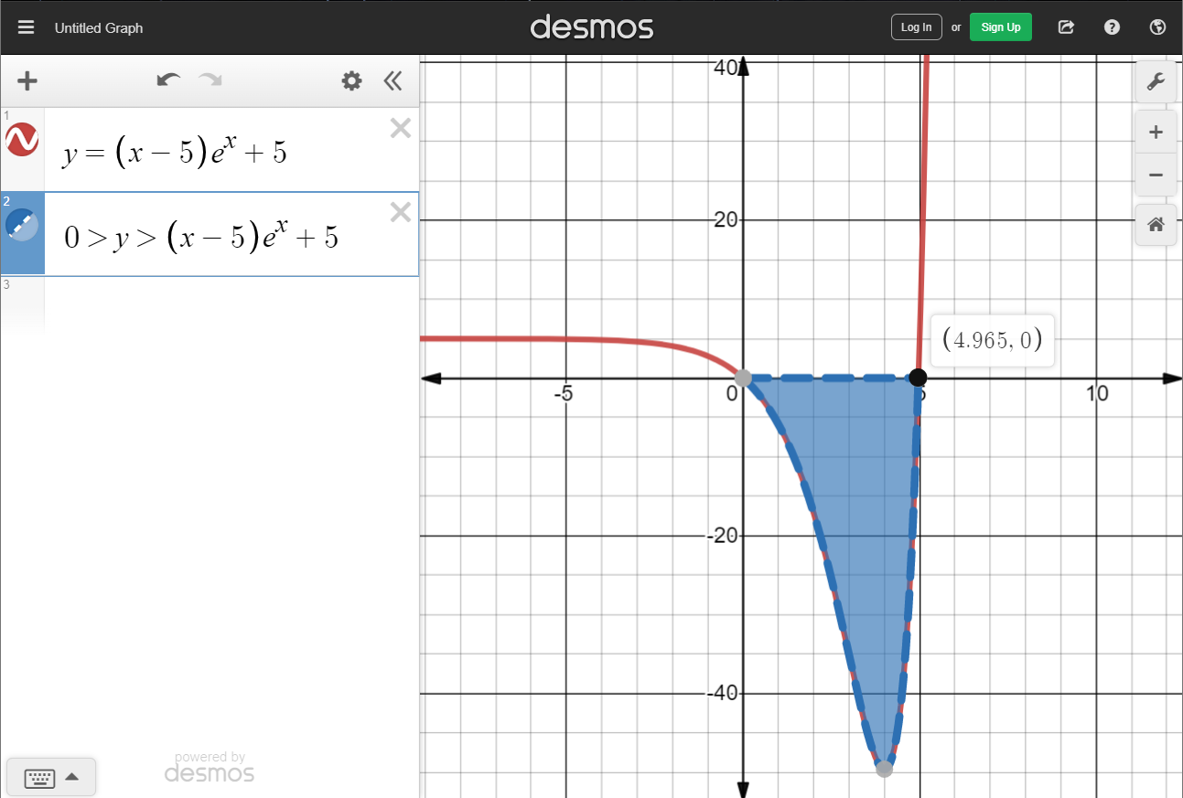

Analytically Solved as the Lambert Wacky Function
$x≈4.965114$

Slide 11
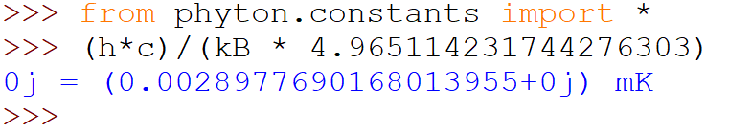

The Derivation (Last One I promise)
$x=\frac{hc}{λ_{max}k_{B}T}$
$λ_{max}=\frac{hc}{k_{B}xT}=\frac{hc}{k_{B}\left(4.965114\right)T}$
Or more precisely, $b=2.897771955185172661 mmK$

